Slide 1
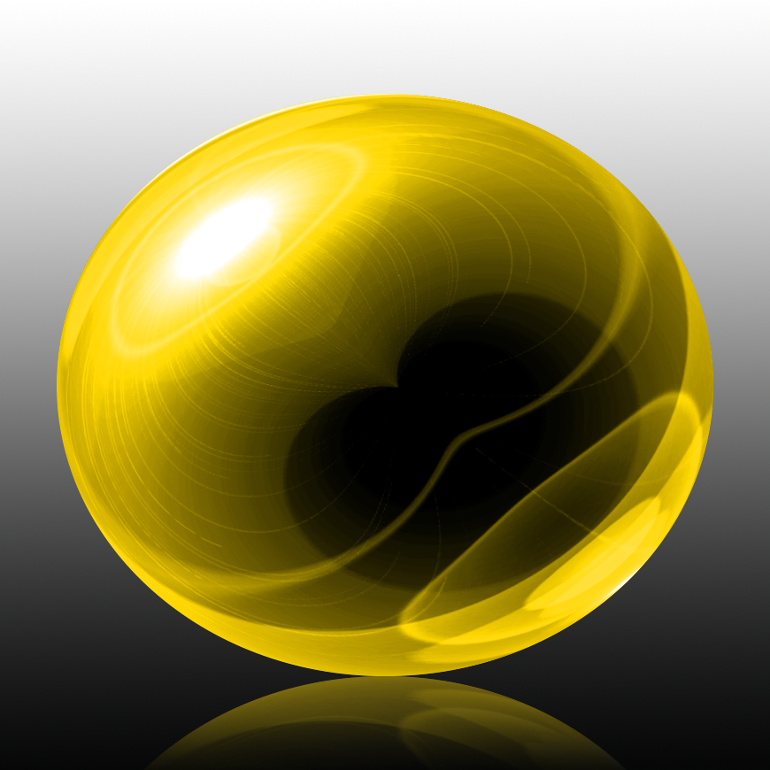
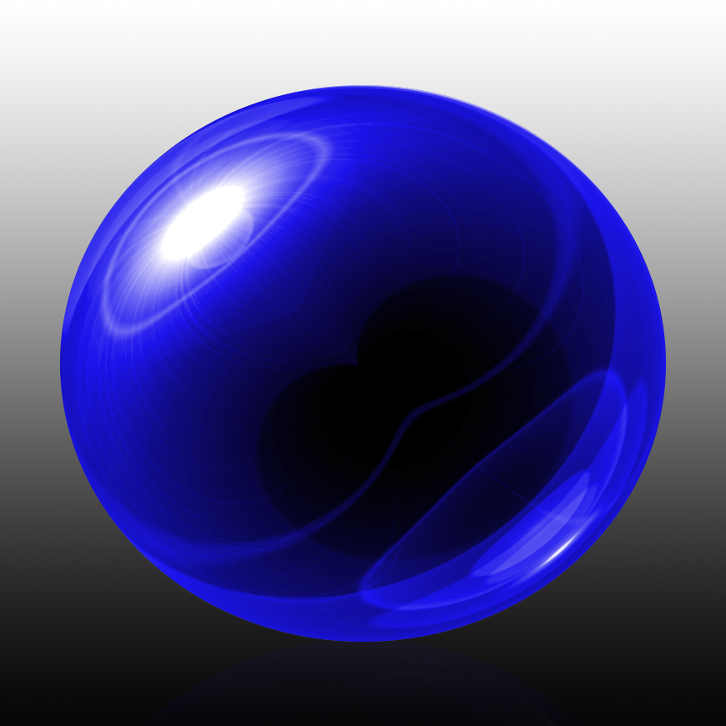
Glass Orb Tutorial

Slide 2
Open Adobe Photoshop and create a new canvas.
File->New
Make width and height 870 pixels
Make resolution 150 pixels/inch
Make Colour Mode RGB
8 Bit

Slide 3
Open Gradient tool (Shortcut G) and make sure the linear gradient icon is active. It is the first option
Click the gradient bar (Next to linear option) This will open gradient editor
Click on the black-white pre-set (third option) and then click ok
Go to the bottom of the canvas and press and hold Shift as you drag the gradient line to the top. Then release

Slide 4
Now it’s time to locate the centre of the canvas.
Click the View window and make sure Rulers + Snap are both checked. If not just click them both to select them.
Go to the ruler at the top (hint look for the numbers) and drag down a Guideline to the centre. It will snap in place because we have snap checked.
Go to the ruler on the left and drag out another guidline until you see it snap to the centre. If you don’t see the guidline click CTRL + H key)

Slide 5
Open your regtangle tool (Shortcut U) than double click the highlighted option until you see a few options.
Click the circle shape.
Go to the centre of the guidelines and drag out a big circular selection.
Than click new layer icon.

Slide 6
If your circle is not yet filled with black click Shift + F5 key to open the fill window
Go to the drop down menu and click black
Deselect your circle if needed by click CTRL + D key

Slide 7
Now let’s fill our circle with a colour.
Double click the thumbnail of the circle to open it’s layer style window.
Click Colour Overlay and than the colour box
Type in the colour code “0078FF” than click ok.
Click inner glow and the colour box and type the code “000D4F” and click ok.
Make Opacity 75%, the source is “Edge” and size is 250 pixels than click ok.

Slide 8
Click the new layer icon to make a new layer. Fill the layer with black
Press:
Shift + F5 this will open the fill window again. Photoshop would have it on black as that is the previously picked option if not click black. Click ok.
Go to
Filter->Render-> Lens Flare
Brightness should be 100%, Lens type 50-300mm Zoom. Click ok.
Go to: Filter->Distort->Polar Co-ordinates and click Polar to Rectangular
Go To: Edit>Transform>Flip Vertical
Go to: Filter->Distort->Polar Co-ordinates and click Rectangular to Polar

Slide 9
Now you should have a round ball/orb shape.
Control + Click on the black circle to make a selection of it’s shape. Click layer mask (Hint 3rd Option on same row as make new layer) to make a layer mask of the selection next to the active layer. Click the chain link to unlink the layer from the mask, as this will allow us to resize/reposition either of them independently of the other. Click The ball/orb to make it active and click CTRL +T to open up Transform Tool.
Go to a corner and Drag it in or out until it is the same size as the circle under it. Than click enter.
Change it’s blending mode to Luminosity.

Slide 10
Now we can brighten the orb by clicking the adjustment layer icon and click levels
In order to prevent the background from brightening let’s make the levels layer into a clipping mask.
Click CTRL+ALT+G. you should see a little downward arrow on the layer.
Make highlight input level 150

Slide 11
Now let’s make a reflection.
Click between the orb and it’s layer mask to link them. Now make a group.
Go to the bottom layer and than shift+Click on the top layer to select all the orb layers and click CTRL + G to group them. Than copy that group. CTRL +J.
Make sure you are on the copy layer and go to, Edit->Transform->Flip Vetical.
Press V to open move tool and than press and hold shift as you drag the copy down until it touches to bottom of the top orb. You can also use the down arrow key .
Reduce the layer’s opacity to between 30-50%.

Slide 12
Now we will fade out the reflection.
Create a layer mask on the group copy layer. Unlink them. Than press G for your gradient tool and drag from the bottom of the canvas to the edge of the orb’s reflection, than release.
To hide the guidelines click CTRL+H

Slide 13
Shift+Click the top folder to make both group layers active and press CTRL+G to make them into another group
Click Adjustment layer icon and click Hue/Saturation. Clip that to the folder to restrict the hue to just the orb and it’s reflection by clicking CTRL+ALT+G. you should see another downward arrow
Drag the hue slider to make the orb and reflection a colour of your choice.

