Slide 1
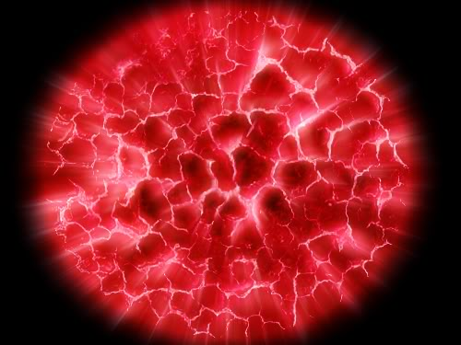
Exploding planets

Slide 2
Open up PAINT.NET and copy this image of mud into it.

Slide 3
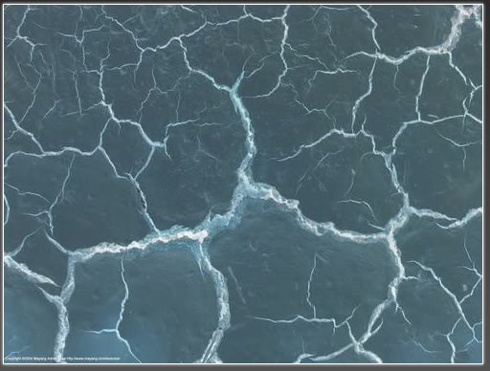
Invert the colour of the image
Click on Adjustments, then Invert Colours

Slide 4
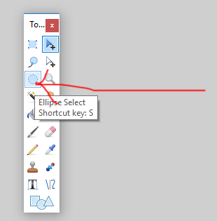
Select the Ellipse tool and select an area of mud.

Slide 5
Invert the selection (Ctrl+I) and press delete

Slide 6
Bulge the image. (Effects -> Distort -> Bulge...) This makes it look round and thus planet-like. I used 48%. Do what looks best for your size of image.

Slide 7
Now fill in the blank section with black.

Slide 8
Duplicate the image so you have two copies of it on different layers

Slide 9
Change the blending mode to “Colour Burn”

Slide 10
Duplicate the image you just did the Colour Burn on and change the blending to Additive.
Then merge all the layers down onto one layer

Slide 11
Add some glow. (Effect -> Photo -> Glow...)

Slide 12
Now duplicate the image. Next do a Zoom Blur. (Effects -> Blurs -> Zoom Blur...) I used 48% use more or less to your liking.

Slide 13
Change the blending mode of the top layer to “lighten”

Slide 14
Turn the saturation to zero (Adjustments -> Hue/Saturation) now merge to one layer.

Slide 15
Try adjusting the Hue to make different colours of planet

