Slide 1
YITZY SCHWEITZER ARSENAL
FROM FREDDIE LJUNGBERG TO NOW

Slide 2
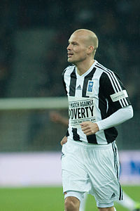
FREDDIE LJUNGBERG (INTERIM MANAGER) NOV. 2019-DEC. 2019
Karl Fredrik Ljungberg is a Swedish former professional footballer who played as a winger and is a football manager. He is currently the assistant coach of Arsenal Football Club after serving as interim head coach in 2019.
Ljungberg was born on 16th April 1977 (aged 43) in Vittsjö, Sweeden
His playing career began in 1982 with Halmstad and ended in 2014 with Mumbai City
His managing career began in 2016 with Arsenal Under Fifteens and he currently serves as the assistant coach of Arsenal after serving as the interim manager in 2019.

Slide 3
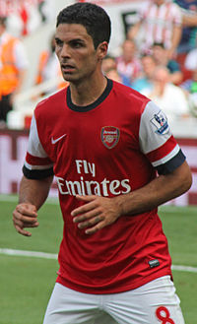
MIKEL ARTETA (CURRENT MANAGER) 2019-
Mikel Arteta Amatriain is a Spanish professional football coach and former player. He is currently the head coach at Premier League club Arsenal. Born in San Sebastián, Arteta played as an attacking and defensive midfielder, and operated primarily as a playmaker.
Arteta was born on 26th March 1982 (aged 38) in Donostia-San Sebastian, Spain
His playing career began in 1991 with Antigouko and ended in 2016 with Arsenal.
His managing career began in 2016 with Manchester City as the assistant coach and he is the current manager of Arsenal.

Slide 4
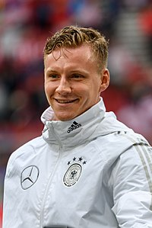
BERND LENO (PLAYER) 2018-
Bernd Leno is a German professional footballer who plays as a goalkeeper for Premier League club Arsenal and the German national team.
Leno was born on 4th March 1992 (aged 28) in Bietigheim-Bissingen, Germany
His playing career in 1998 with SV Germania Bietigheim and he currently plays for Arsenal as #1

Slide 5
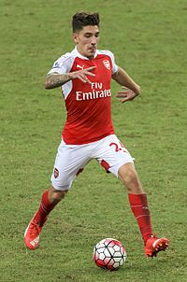
HECTOR BELLERIN (PLAYER) 2011-
Héctor Bellerín Moruno is a Spanish professional footballer who plays as a right back or wing back for the Spain national team and Premier League club Arsenal, where he is currently serving as the team's vice-captain.
Bellerin was born on 19th March 1995 (aged 25) in Barcelona, Spain
His playing career began in 2003 with Barcelona and he currently plays for Arsenal as #2

Slide 6
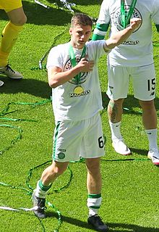
KIERAN TIERNEY (PLAYER) 2019-
Kieran Tierney is a Scottish professional footballer who plays for Premier League side Arsenal and the Scotland national team as a left back. Born on the Isle of Man, Tierney moved to Lanarkshire at a young age.
Tierney was born on 5th June 1997 (aged 22) in Douglas, Isle of Man
His playing career began in 2005 with Celtic and he currently plays for Arsenal as #3

Slide 7
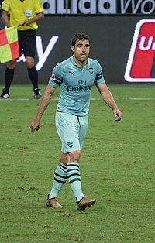
SOKRATIS PAPASTATHOPOULOS (PLAYER) 2018-
Sokratis Papastathopoulos, commonly known by the singular name Sokratis, is a Greek professional footballer who plays as a centre back for Premier League club Arsenal and the Greece national team.
Papastathopoulos was born on 9th June 1988 (aged 31) In Kalamata, Greece
It is unknown when he began his career however the first signing that is dated is his 2004 signing for AEK Athens and he currently plays for Arsenal as #5

Slide 8
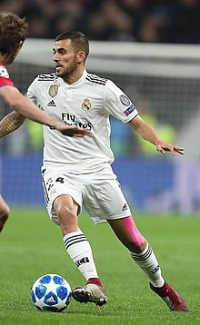
DANI CEBALLOS (LOANED PLAYER) 2019-
Daniel Ceballos Fernández is a Spanish professional footballer who plays for Arsenal, on loan from Real Madrid, and the Spain national team as a central midfielder.
Ceballos was born on 7th August 1996 (aged 23) In Utrera, Spain
His playing career began in 2004 with Sevilla and he currently plays for Arsenal on loan from Real Madrid as #8

Slide 9
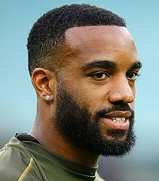
ALEXANDRE LACAZETTE (PLAYER) 2017-
Alexandre Lacazette is a French professional footballer who plays as a forward for Premier League club Arsenal and the France national team. He is known for his pace, hold-up play, and work-rate. Lacazette plays mainly as a striker, but has also been deployed as a second striker, and wide forward.
Lacazette was born on 28th May 1991 (aged 28) in Lyon, France
His playing career began in 1998 with ELCS Lyon and he currently plays for Arsenal as #9

Slide 10
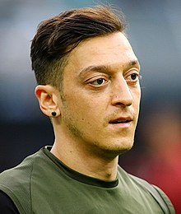
MESUT OZIL (PLAYER) 2013-
Mesut Özil is a German professional footballer who plays for Premier League club Arsenal. He is considered to be one of the best players in the world. Özil plays mostly as an attacking midfielder, but can also be deployed as a winger.
Ozil was born on 15th October 1988 (aged 31) In Gelsenkirchen, Germany
His playing carer began in 1995 with Westfalia 04 Gelsenkirchen and He currently plays for Arsenal as #10

Slide 11
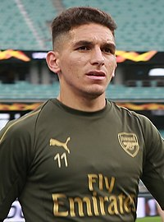
LUCAS TORREIRA (PLAYER) 2018-
Lucas Sebastián Torreira Di Pascua is a Uruguayan professional footballer who plays as a defensive midfielder for Premier League club Arsenal and the Uruguay national team
Torreira was born on 11th February 1996 (aged 24) in Fray Bentos, Uruguay
His playing career began in 2010 with 18 de Julio and he currently plays for Arsenal as #11

Slide 12
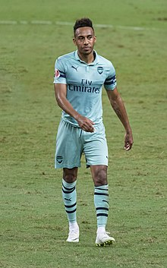
PIERRE-EMERICK AUBAMEYANG (PLAYER) 2018-
Pierre-Emerick Emiliano François Aubameyang is a professional footballer who plays as a forward and is the captain of both Premier League club Arsenal and the Gabon national team. He is considered to be one of the best forwards in the world, known for his pace, finishing, and off-ball movement.
Aubameyang was born on 18th June 1989 (aged 30) In Laval, France
His playing career began in 1995 with ASL L'Huisserie Football and he currently plays for Arsenal as #14

Slide 13
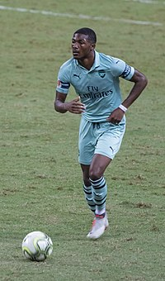
AINSLEY MAITLAND-NILES (PLAYER) 2003-
Ainsley Cory Maitland-Niles is an English professional footballer who plays as a midfielder, winger or right back for Premier League club Arsenal. He spent the 2015–16 season on loan at Ipswich Town. Internationally, he has represented England from under-17 to under-21 level.
Maitland-Niles was born on 29th August 1997 (aged 22) in Goodmayes, Ilford
His playing career began in 2003 with Arsenal. He still plays for them as #15

Slide 14
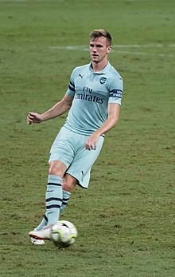
ROB HOLDING (PLAYER) 2016-
Robert Samuel Holding is an English professional footballer who plays as a centre back for Premier League club Arsenal. Holding progressed through the Bolton Wanderers youth system, making his senior debut in April 2015 while on loan at Bury.
Holding was born on 20th September 1995 (aged 24) in Tameside, Greater Manchester
His playing career began in 2002 with Bolton Wanderers and he currently plays for Arsenal as #16

Slide 15
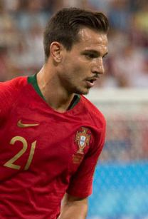
CEDRIC SOARES (LOANED PLAYER) 2020-
Cédric Ricardo Alves Soares CvIH ComM, known simply as Cédric, is a Portuguese professional footballer who plays as a right back for Premier League club Arsenal on loan from Southampton and the Portugal national team.
Soares was born on 31st August 1991 (aged 28) in Singen, Germany
His playing career began in 1998 with Sporting CP and he currently plays for Arsenal on loan from Southampton as #17

Slide 16
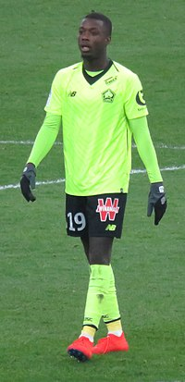
NICOLAS PEPE (PLAYER) 2019-
Nicolas Pépé is a professional footballer who plays as a winger for English Premier League club Arsenal and the Ivory Coast national team.
Pepe was born on 29th May 1995 (aged 24) in Mantes-la-Jolie, France
It is unknown when he began his career however the first signing that is dated is his 2013 signing for Angers II and he currently plays for Arsenal as #19

Slide 17
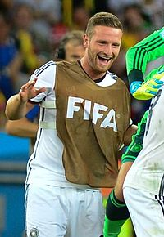
SHKODRAN MUSTAFI (PLAYER) 2016-
Shkodran Mustafi is a German professional footballer who plays as a centre back for Premier League club Arsenal and the German national team.
Mustafi was born on 17th April 1992 (aged 28) in Bad Hersfeld, Germany
It is unknown when he began his career however the first signing that is dated is his 2006 signing for Hamburger SV and he currently plays for Arsenal as #20

Slide 18
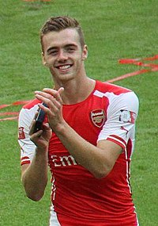
CALUM CHAMBERS (PLAYER) 2014-
Calum Chambers is an English professional footballer who plays as a defender for Premier League club Arsenal and the England national team. Originally a member of Southampton's academy system, Chambers was promoted to the first team at the beginning of the 2012–13 campaign.
Chambers was born on 20th January 1995 (aged 25) in Petersfield
His playing career began in 2002 with Southampton and he currently plays for Arsenal as #21

Slide 19
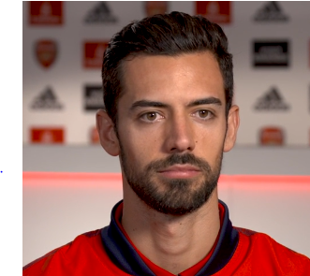
PABLO MARI (LOANED PLAYER) 2020-
Pablo Marí Villar is a Spanish professional footballer who plays as a centre back for Premier League club Arsenal, on loan from Flamengo of Série A.
Mari was born on 31st August 1993 (aged 26) in Almussafes, Spain
It is unknown when he began his career however the first signing that is dated is his 2010 signing for Mallorca B and he currently plays for Arsenal on loan from Flamengo as #22

Slide 20
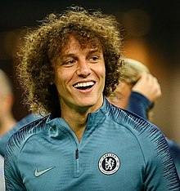
DAVID LUIZ (PLAYER) 2019-
David Luiz Moreira Marinho is a Brazilian professional footballer who plays for Premier League club Arsenal and the Brazil national team. Primarily a centre back, he can also be deployed as a defensive midfielder. After starting out at Vitória, he moved to Benfica, remaining with the club for five seasons
Luiz was born on 22nd April 1987 (aged 33) in Diadema, State of Sao Paulo, Brazil
His playing career began in 1999 with Sao Paulo and he currently plays for Arsenal #23

Slide 21
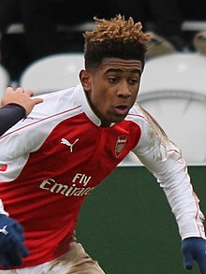
REISS NELSON (PLAYER) 2007-
Reiss Luke Nelson is an English professional footballer who plays as a forward for Premier League club Arsenal.
Nelson was born on 10th December 1999 (aged 20) in Elephant and Castle, London
His playing career began in 2007 with Arsenal. He still plays for them #24

Slide 22
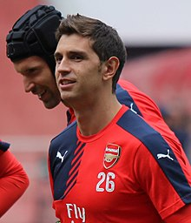
EMILIANO MARTINEZ (PLAYER) 2010-
Damián Emiliano Martínez Romero is an Argentine professional footballer who plays as a goalkeeper for Premier League club Arsenal.
Martinez was born on 2nd September 1992 (aged 27) in Mar del Plata, Argentina
His playing career began in 2008 with Independiente and he currently plays for Arsenal as #26

Slide 23
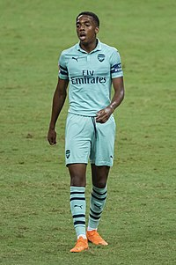
JOE WILLOCK (PLAYER) 2004-
Joseph George Willock is an English professional footballer who plays as a midfielder for Premier League club Arsenal.
Willock was born on 20th August 1999 (aged 20) in Waltham Forest
His playing career began in 2004 with Arsenal. He still plays for them as #28

Slide 24
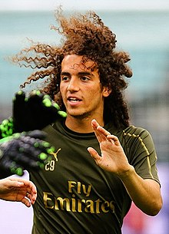
MATTEO GUENDOUZI (PLAYER) 2018-
Matteo Elias Kenzo Guendouzi Olié is a French professional footballer who plays as a midfielder for Premier League club Arsenal and the French under-21 team.
Guendouzi was born on 14th April 1999 (aged 21) In Poissy, France
His playing career began in 2005 with Paris Saint-Germain and he currently plays for Arsenal as #29

Slide 25
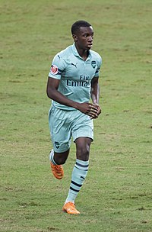
EDDIE NKETIAH (PLAYER) 2015-
Edward Keddar Nketiah is an English professional footballer who plays as a striker for Premier League club Arsenal, and the England national under-21 team.
Nketiah was born on 30th May 1999 (aged 20) in Lewisham, London
His playing career began in 2008 with Chelsea and he currently plays for Arsenal as #30

Slide 26
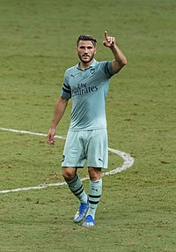
SEAD KOLASINAC (PLAYER) 2017-
Sead Kolašinac is a Bosnian professional footballer who plays as a left back for Premier League club Arsenal and the Bosnia and Herzegovina national team.
Kolasinac was born on 20th June 1993 (aged 26) In Karlsruhe, Germany
His playing career began in 2001 with Karlsruher SC and he currently plays for Arsenal as #31

Slide 27
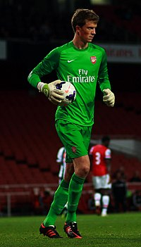
MATT MACEY (PLAYER) 2013-
Matthew Ryan Macey is an English professional footballer who plays as a goalkeeper for Premier League club Arsenal.
Macey was born on 9th September 1994 (aged 25) in Bath
His playing career began in 2009 with Bristol Rovers and he currently plays for Arsenal as #33

Slide 28
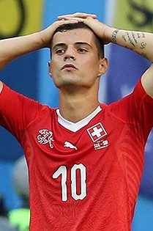
GRANIT XHAKA (PLAYER) 2016-
Granit Xhaka is a Swiss professional footballer who plays as a midfielder for Premier League club Arsenal and the Swiss national team. Xhaka began his career at hometown club Basel, winning the Swiss Super League in each of his first two seasons.
Xhaka was born on 27th September 1992 (aged 27) in Basel, Switzerland
His playing career began in 2000 with Conordia Basel and he currently plays for Arsenal as #34

Slide 29
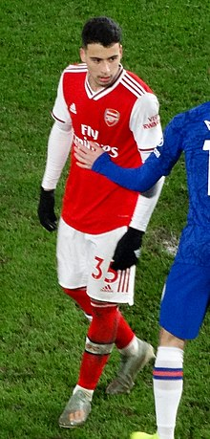
GABRIEL MARTINELLI (PLAYER) 2019-
Gabriel Teodoro Martinelli Silva, known as Gabriel Martinelli or simply Martinelli, is a Brazilian professional footballer who plays as a forward for Arsenal.
Martinelli was born on 18th June 2001 (aged 18) in Guarulhos, Brazil
His playing career began in 2010 with Corinthias and he currently plays for Arsenal as #35

Slide 30
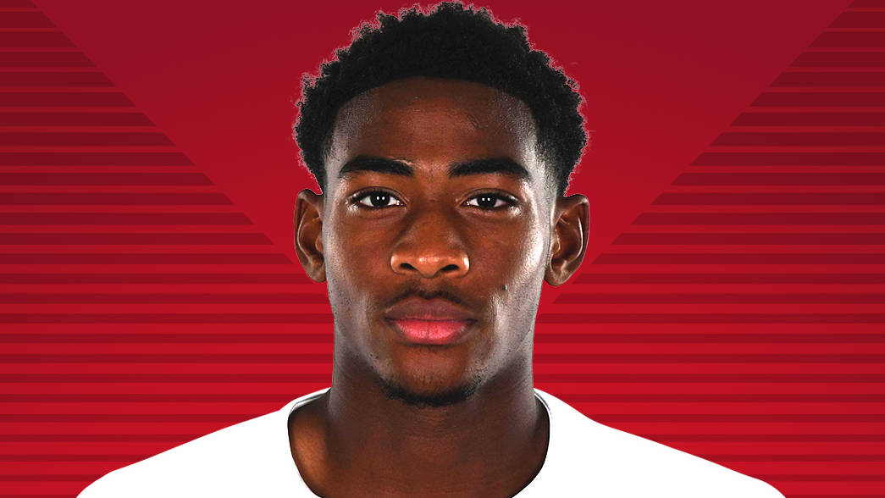
ZECH MEDLEY (PLAYER) 2016-
Zechariah Joshua Henry Medley is an English professional footballer who plays as a centre back for Arsenal in the Premier League.
Medley was born on 9th July 2000 (aged 19) In Greenwich
His playing career began in 2008 with Chelsea and he currently plays for Arsenal as #49

Slide 31
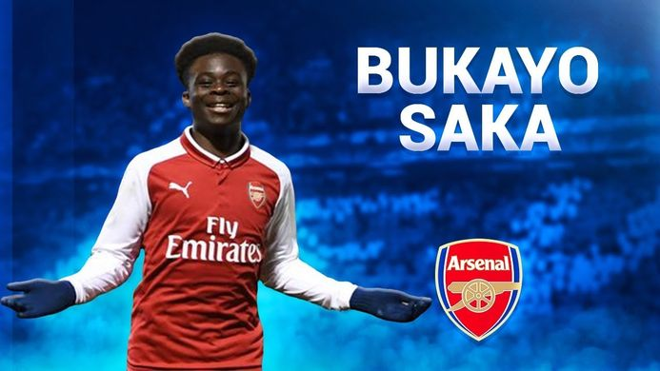
BUKAYO SAKA (PLAYER) 2018-
Bukayo Saka is an English professional footballer who plays as a winger for Arsenal in the Premier League.
Saka was born on 5th September 2001 (aged 18) in London
It is unknown when he began his career however he was part of the Arsenal Academy making his professional debut for the first team in 2018. He still plays for them as #77

Slide 32
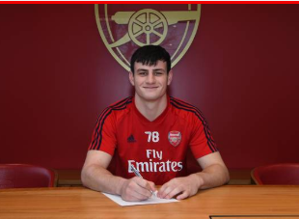
TOM SMITH (PLAYER) 2018-
Tom Smith Is an English professional footballer who plays as a goalkeeper for Premier League club Arsenal.
Smith was born on 30th January 2002 (aged 18) in England.
His playing career began in 2018 with Arsenal. He still plays for them as #78

Slide 33
CREDITS:
PRODUCED AND ANIMATIONS: YITZY SCHWEITZER
MAIN INFORMATION: WIKIPEDIA
PICTURES: WIKIPEDIA, ARSENAL.COM GOOGLE IMAGES AND BCC SPORT
© YITZY SCHWEITZER/MIDNIGHT ASSOCIATES

